Slide 1


PRESENTATION
NEW YORK TAXI OPERATION
Long Pham - Data Analytics Initial Report

Slide 2

CONTENTS
Introduction
Data Cleaning and Processing
Features with strong relationships
Neighborhoods that love Taxi
Improving Operations:
Traffic Jams?
What time and where do New Yorkers need Taxi?
What day to increase cabs? A hint about holidays
Model with 20% tips:
What’s next?
Question and Answers

Slide 3


1. INTRODUCTION
LONG PHAM
DATA ANALYTICS
Data Analytics at dotData (Current)
MBA specialized Marketing
Post-Graduate Data Analytics at Langara (Current)
Previous work experience as a contractor at Microsoft

Slide 4


2. DATA CLEANING AND PROCESSING
2015 data was merged, cleaned, and processed.
Unfamiliar inputs (outliers) were removed for more accurate analysis and predictions.
There was no missing values, therefore no imputations needed for the datasets.

Slide 5
3. FEATURES WITH STRONG RELATIONSHIPS
Technical Information
1
Payment type - Drop-off borough
p value < 0.01
2
Payment type - Passenger Count
p value < 0.01
3
Tip amount - Drop-off borough
p value < 0.01
Highest average tip for drop-off: Staten Island at $7.21

Slide 6


4. NEIGHBORHOODS THAT LOVE TAXI
Chelsea and Clinton: Nearly 300,000 trips in 2015
PLACE MORE CABS HERE?
Gramercy Park and Murray Hill: Around 250,000 trips
Upper West Side: Around 102,000 trips
Greenwich Village and Soho: 99,000 trips
Lower Manhattan: Nearly 54,000 trips

Slide 7

5. IMPROVING OPERATION (TRAFFIC JAMS?)
MOST HEAVY TRAFFIC NEIGHBORHOODS
Neighborhood Names | Average Duration per Trip (Mins)
Rockaways | 28.01
Canarsie and Flatlands | 14.96
Central Queens | 12.22
Northeast Queens | 11.64

Slide 8

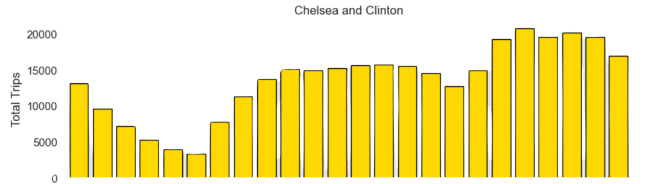
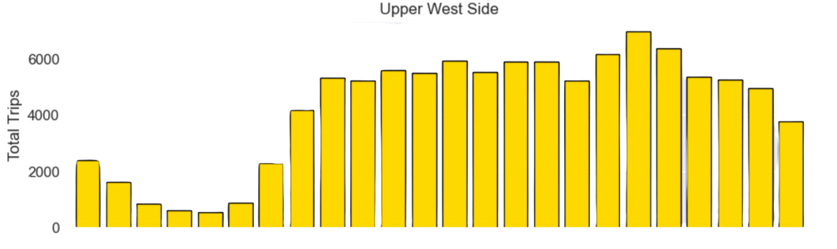
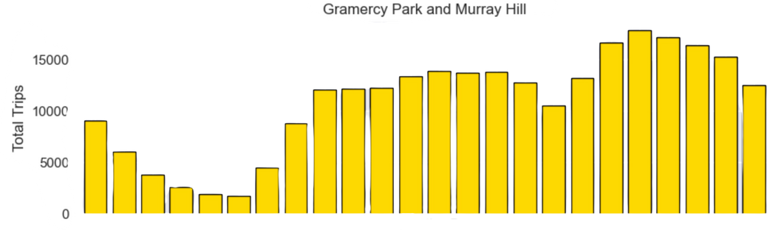
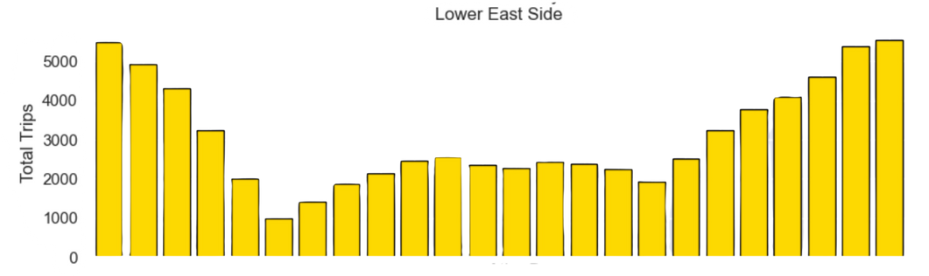
5. IMPROVING OPERATIONS
What time and where do New Yorkers need Taxi?
New York never sleeps!
Each areas have very different active times

Slide 9
5. IMPROVING OPERATIONS
What day to increase cabs? A hint about holidays
Example Holiday Names | Days of the week | Average Trip | Holiday Trip
New Years Day | Thursday | 3386 | 2888
Independence Day (observed) | Saturday | 3570 | 3844
Memorial Day | Monday | 2942 | 2232

Slide 10


6. MACHINE LEARNING MODEL
To predict if a trip will receive over 20% tips or not
Random Forrest Model was trained and used, because:
Fast and efficient
It avoids Bias and reduces Biases and Errors
Highly stable and can work with different types of data, especially good with classification

Slide 11


6. MACHINE LEARNING MODEL (CONTINUED)
Overall Analysis:
Model has a high accuracy of 81% overall.
Performs very well in identifying cases of tips > 20%.
Have misses some cases where tip is low
Top Features importance:
Payment Type: 45.4%
Dropoff_latitude: 6.38%
Pickup_longitude: 6.37%
Dropoff_longitude: 6.31%
Pickup_minutes (At what time of the day): 6.15%

Slide 12


7. WHAT’S NEXT? - FINAL REPORT
Topics are included in the final report
More strong pair relationship features
Operation Analysis based on weather conditions.
Detail Analysis of Tip Amount per Neighborhood
Revenue report per Seasons
Comprehensive report data and tables for all above discussion
Fine-tuned and Accuracy Boost for Machine Learning Model
Adjust to keep improving the Model’s results

Slide 13





Question and Answer?

Slide 14

THANK YOU FOR YOUR TIME

